Slide 1

Face Mask Detection using live video streaming
St. Francis Institute of Technology
Department of Computer Engineering
Guided by- Ms. K Priya Karunakaran
Group Members
.
Name | Roll No.
Yogita Likhi | 46
Sherwin Mathias | 53
Ujala Maurya | 54
Nithin Menezes | 58

Slide 2
Content
Introduction
Literature
Problem Statement
Proposed Solution
Work Flow of the system
Algorithm with Implementation details
Experimental Set-Up
Data Set
Performance Evaluation Parameters
Validation with Test Cases
Results & Discussion
Conclusion
References

Slide 3
Introduction
COVID-19 pandemic is the most life-changing event which has startled the world since the year 2020.
Masks, Sanitizer and social distancing became the priority of each and every person.
A survey shows that 90% of people in India are aware of wearing a mask, but only 44% of them are wearing a face mask.
To monitor that people are following this basic safety principle, a strategy should be developed. A face mask detector system can be implemented to check this.

Slide 4
Introduction
Further, with the reopening of countries from COVID-19 lockdown, Government and Public health agencies are recommending face mask as essential measures to keep us at bay from the spread of the virus
Our project i.e. Face mask Detection makes the process of checking face mask on a person fast and efficient. It can be deployed in malls, schools, college, etc.

Slide 5
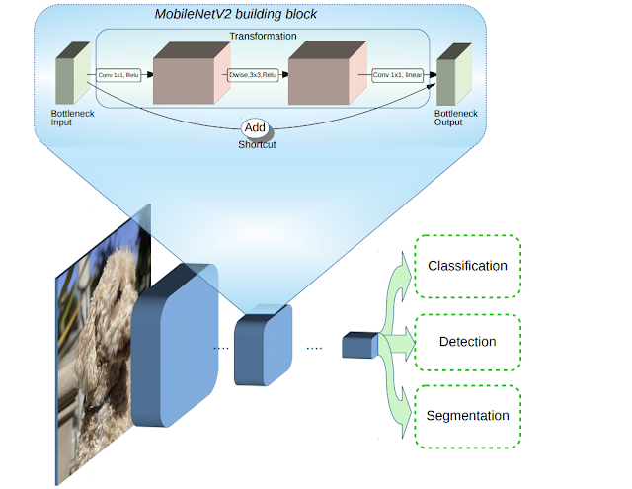
Literature Review
Fig 1: Overview of MobileNetV2 Architecture (Ref[1])

Slide 6
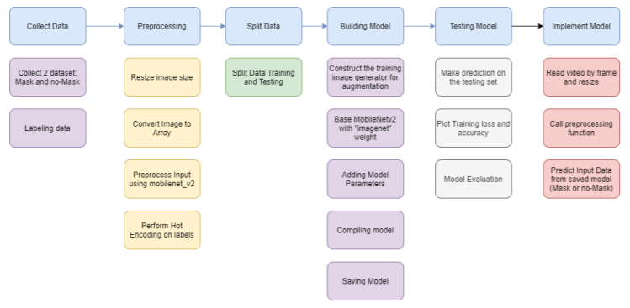
Fig 2: Face mask detection in Image (Ref[2])

Slide 7
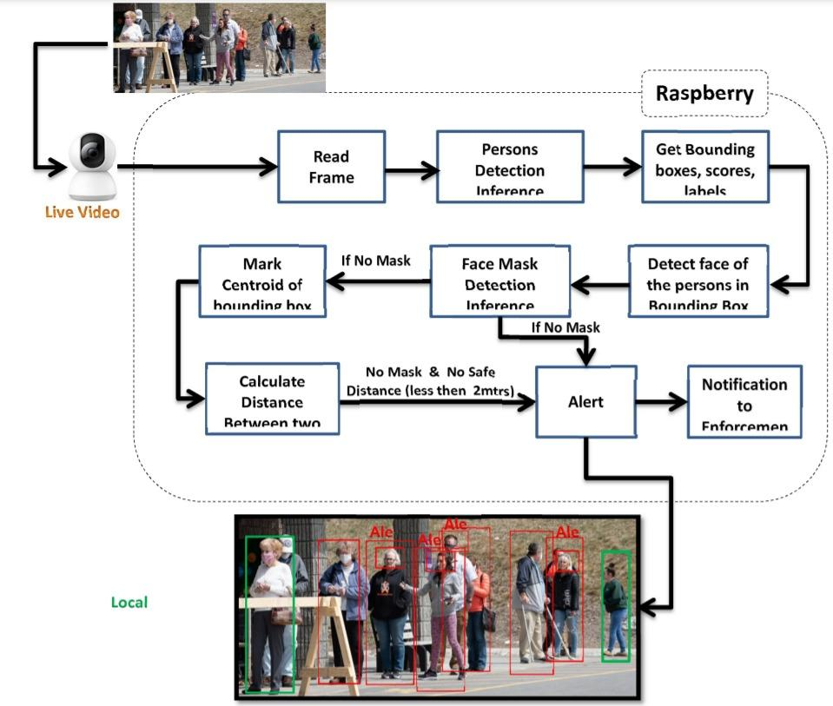
Fig 3: Face Mask detection in video (Ref [3])

Slide 8
Problem Statement
To provide a system to monitor people who are not wearing mask by taking live video as input and detecting the people not wearing mask with a red box. The system should also be able to recognize that person and keep a track of the violation count and send him/her a warning through email or messaging system after a specific number of counts crossed.

Slide 9
Proposed Solution
In our project we are using CNN based MobileNetV2 Architecture for Mask Detector Model.
For live streaming as well as capturing of the faces we are using OpenCV along with Haar Face Detector.
For Face Detection, we are using the FaceNet algorithm and the Face Recognition library.

Slide 10
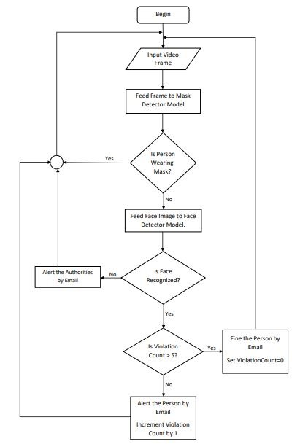
Work Flow of the system
Fig 4: Workflow of the system

Slide 11
Algorithm with Implementation Details
Mask Detection:
In our project we are using CNN based MobileNetV2 Architecture for Mask Detector Model. For live streaming as well as capturing of faces we are using OpenCV along with Haar Face Detector.
Face Recognition:
For Face Recognition model, we are using FaceRecognition library to extract encodings of captured faces and FaceNet model to compute the similarity between faces. For live streaming as well as capturing of faces we are using OpenCV along with Haar Face Detector.

Slide 12
Experimental Setup
The system uses two datasets, one for training mask detection model and other for face recognition model.
The dataset for mask detection model is taken from Kaggle. The collected data is labelled into two groups; with and without mask.
Before the model creation, first we need to pre-process the data.
Then we split into two groups which is training data (80%) and testing data (20%). Each group is containing both: with and without mask images.
Next step is to build the face mask detector model with base model MobileNetV2 and train it followed by saving the trained model.

Slide 13
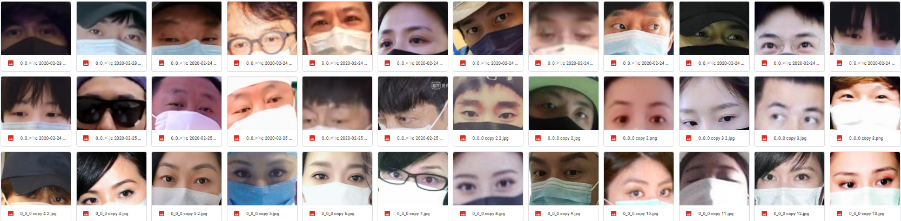
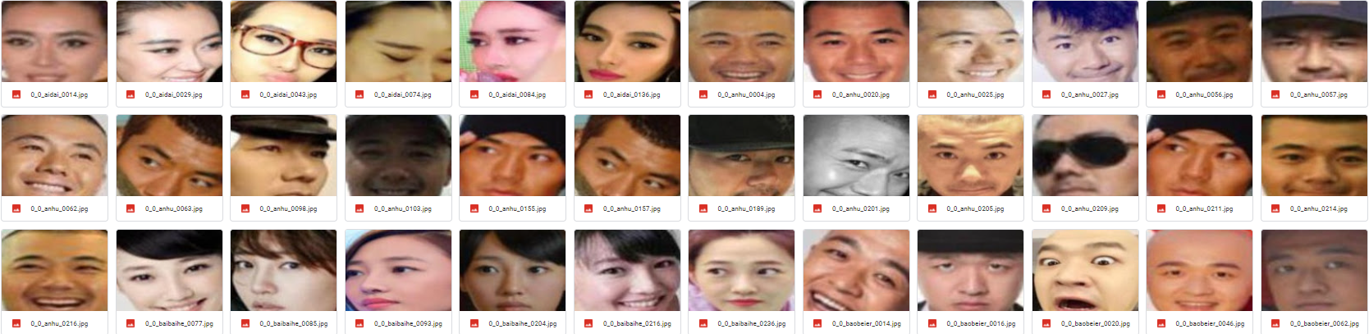
Fig 5: Mask system dataset

Slide 14
Experimental Setup
The dataset for face recognition model is taken through captured images. The collected data is labelled by a unique identification number such as PID.
We store the images in a folder. Whenever, our face recognition model starts running, it extracts the encoding of each image one by one and stores it in the form of array for further executions and comparisons.

Slide 15
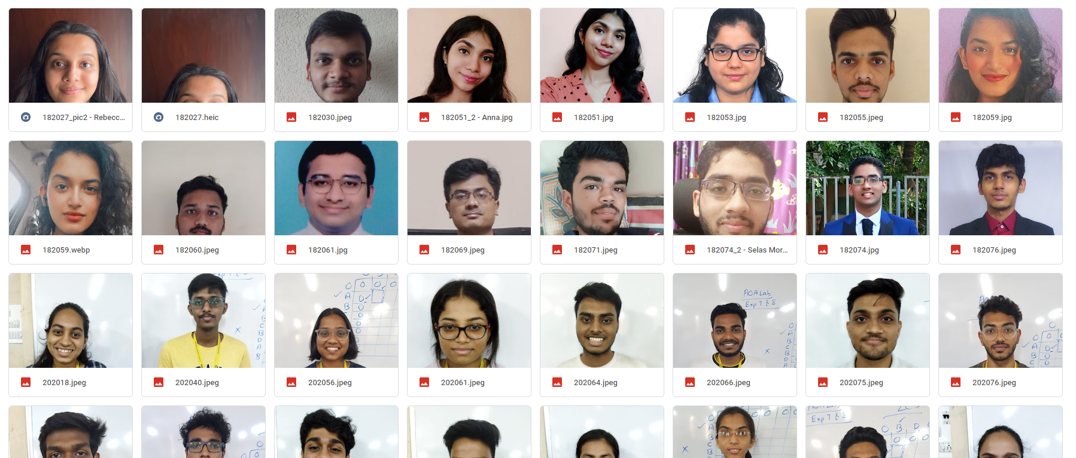
Fig 6: Face recognition dataset

Slide 16
Experimental Setup
The project works for a webcam.
It also gave good results when connected with mobile camera.
Considered only one real-time input for the project
In case of violation count, a time frame of one hour is kept for each person
A beep sound is produced to indicate that someone is out there without a mask.
A warning mail can be sent manually to individual persons as well as to all the persons who violated more than 5 times automatically.

Slide 17
Validation with Test cases
Students with mask will be shown in green box and without mask will be shown with red box along with the student details and the violation count will be updated automatically.
We have created a dedicated dashboard to see all the details of the rule-violating students like Name, PID, Violation Count, etc.
Violations count of students are filtered based on Department, we can also view the recorded count of students yesterday and today and make a comparison.
Graphs are also shown for analytics and inferences which give an ease of understanding.
Notifications can be sent with an email to the violating student as a warning.

Slide 18
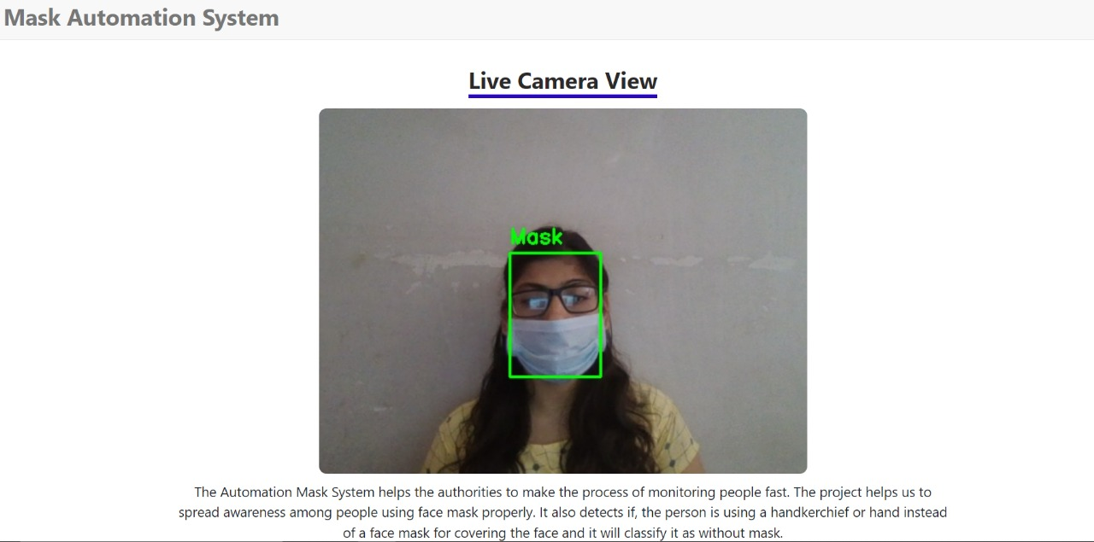
Fig 7: Student wearing a proper face mask will be shown in green box
Validation with Test cases

Slide 19
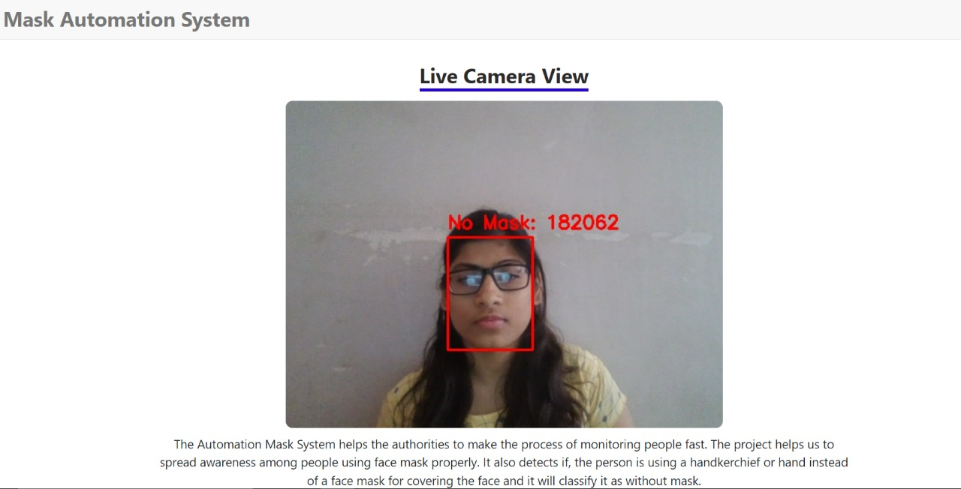
Fig 8: Student without a face mask will be shown in red box along with their PID
Validation with Test cases

Slide 20
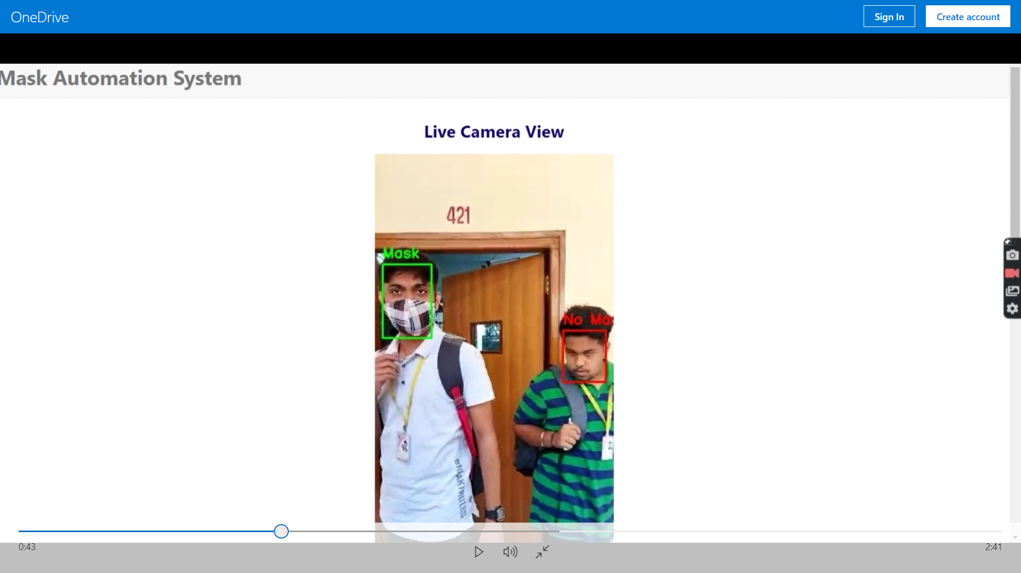
Fig 9: Testing the model in college premises
Validation with Test cases

Slide 21
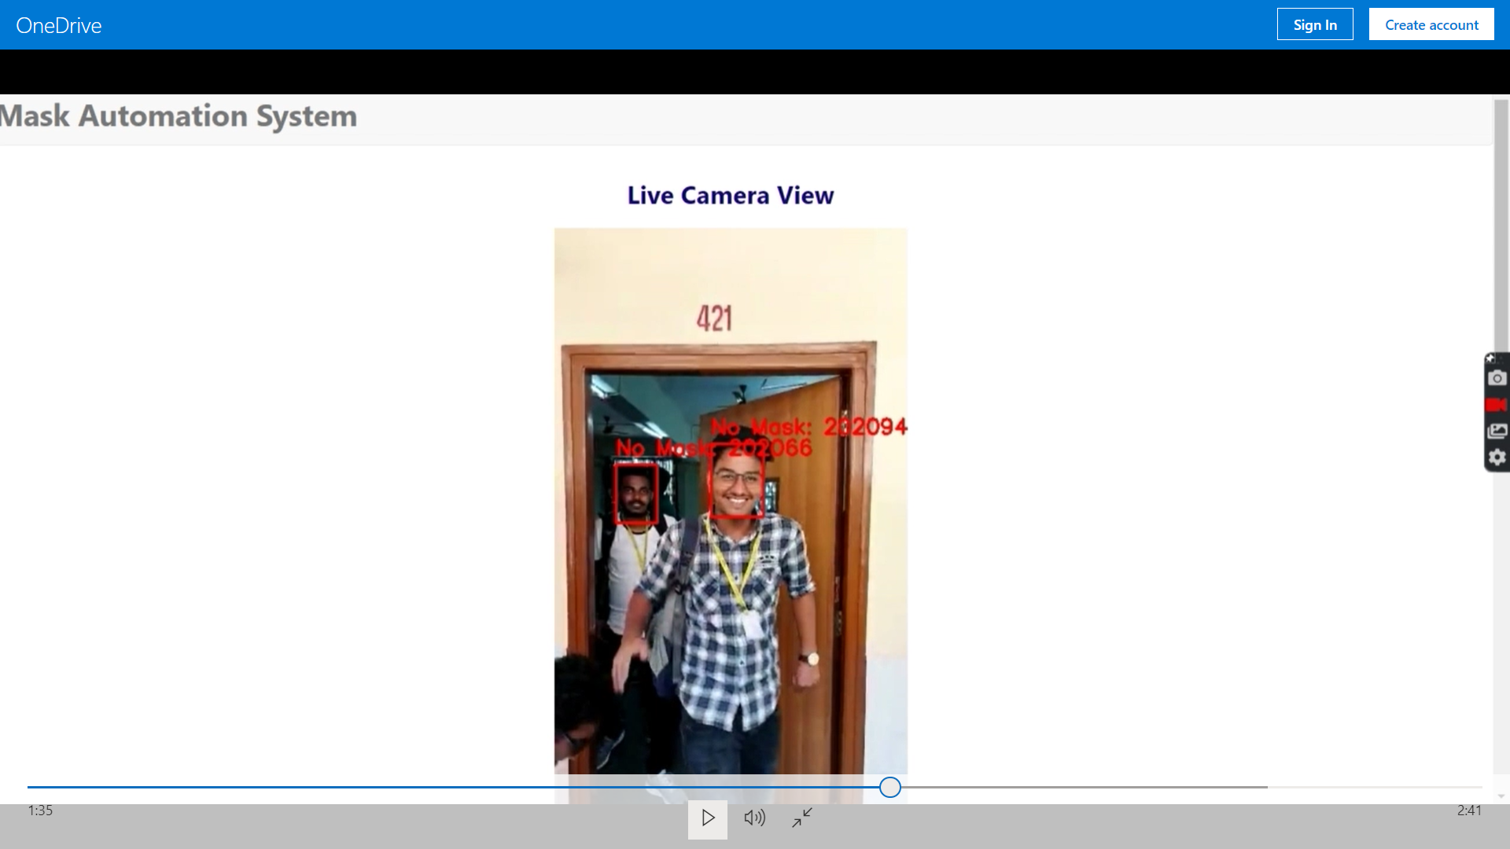
Fig 10: Testing the model in college premises
Validation with Test cases

Slide 22
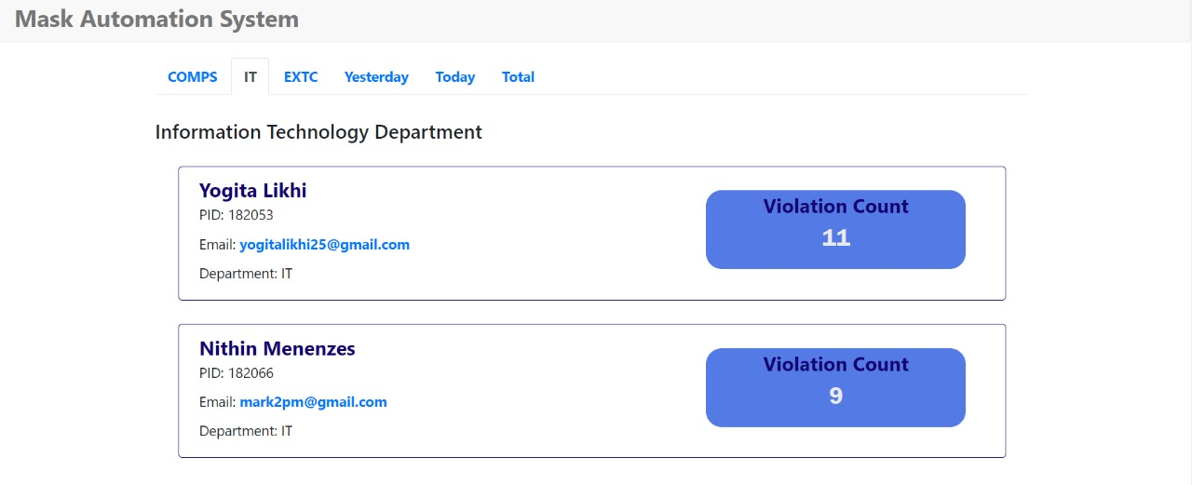
Fig 11: Violation count of students in a particular department
Results and Discussions

Slide 23
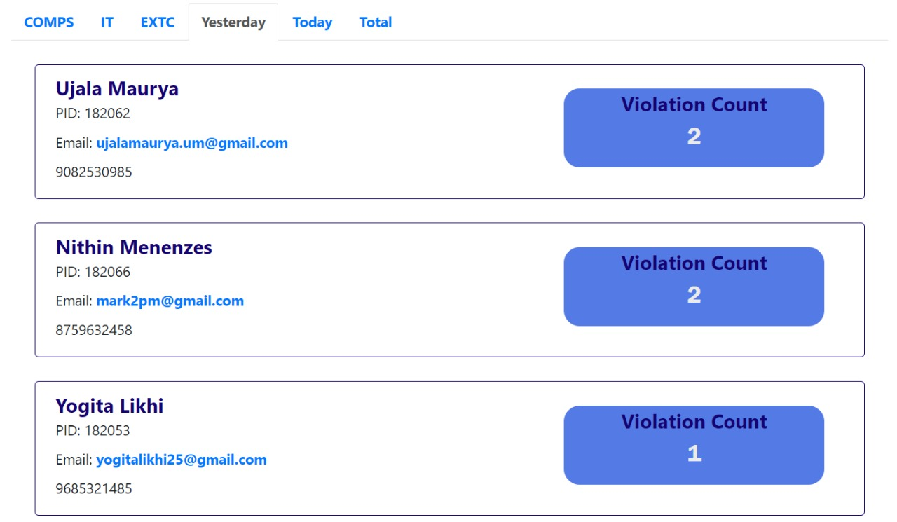
Results and Discussions
Fig 12: Violation count of students recorded yesterday

Slide 24
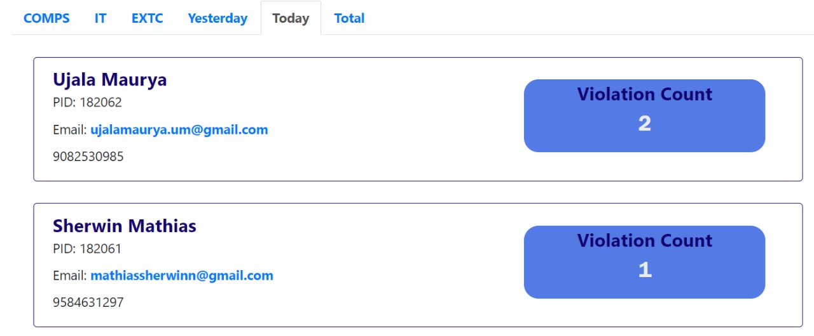
Results and Discussions
Fig 13: Violation count of students recorded today

Slide 25
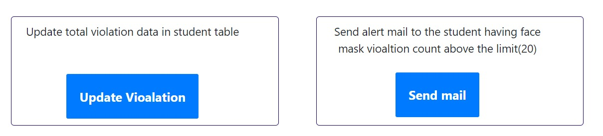
Results and Discussions
Fig 14: We can update violations and send email as a warning to the person

Slide 26
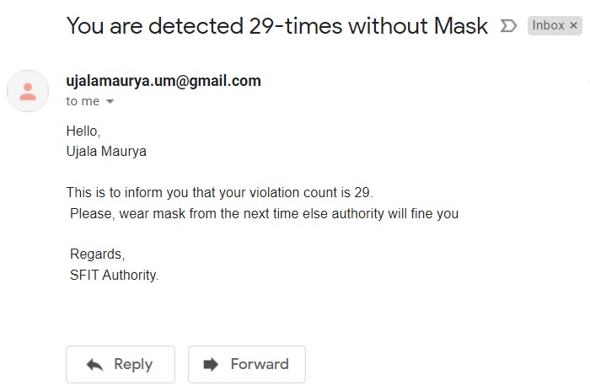
Results and Discussions
Fig 15: Format in which the mail will be sent to the student

Slide 27
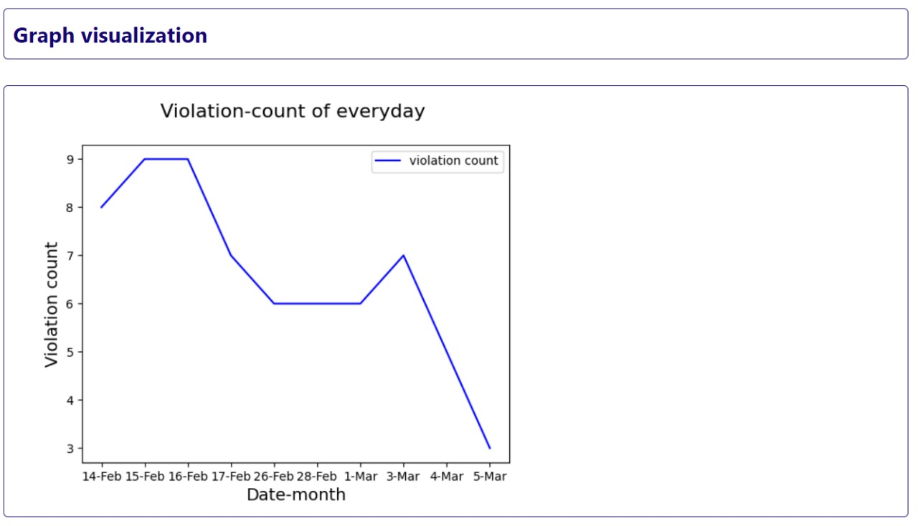
Results and Discussions
Fig 16: Violation count ordered by each Day

Slide 28
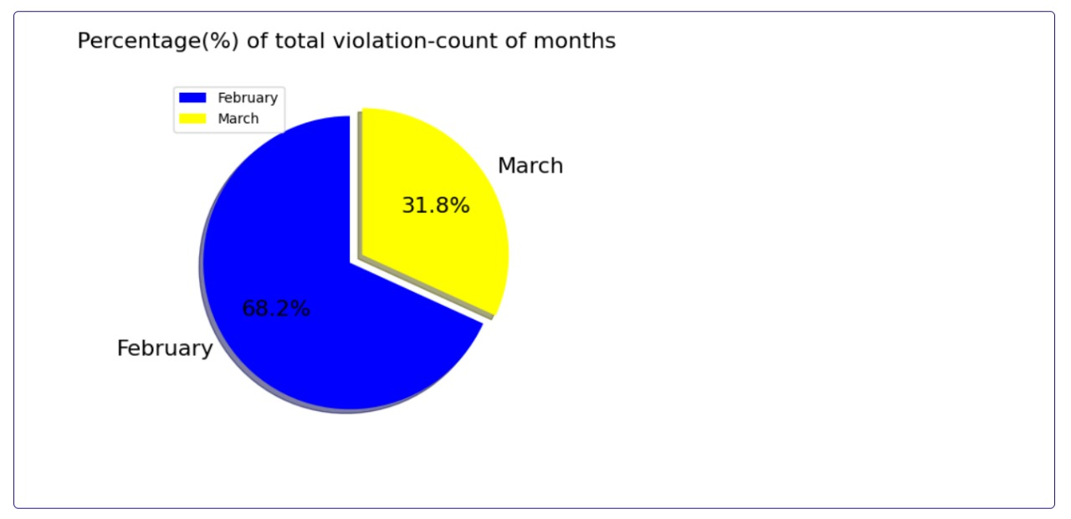
Results and Discussions
Fig 17: Violation count ordered by each Month

Slide 29
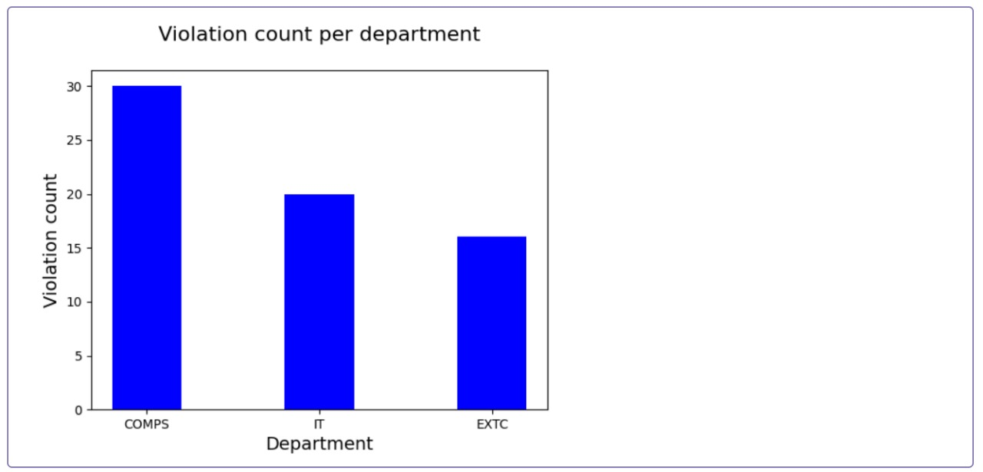
Results and Discussions
Fig 18: Violation count ordered by each Department

Slide 30
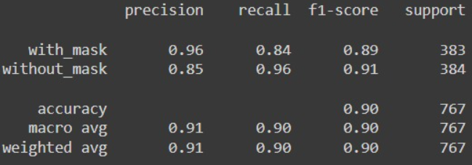
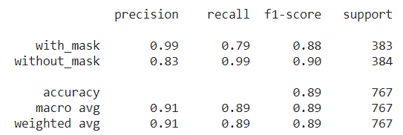
Results and Discussions
To compare our model with others, we have trained two models using the same dataset from Kaggle.
The following table shows the analysis done.
Model | Dataset | Accuracy (%)
MobilenetV2 | Mask Detection Dataset (from Kaggle) | 89
Resnet50 | Mask Detection Dataset (from Kaggle) | 90
Table 1: Comparison between different models

Slide 31
Results and Discussions
If we compare the results shown in Table 1, MobilenetV2 has an accuracy of 89% and Resnet50 has an accuracy of 90%
Deep neural networks like Resnet models come with the tradeoff of memory, data speed and time.
Even in real world applications such as an autonomous vehicles or robotic visions, the object detection task must be done on the computationally limited platform.
In these cases, MobilenetV2 models are preferred as they are space and time efficient.
Hence, we decided to proceed with the MobilenetV2 model.

Slide 32
Results and Discussions
Our final model executes and gives effective and desired results.
It gives correct output for one wearing masks and one who are not.
The system gives out a beep sound to indicates that there is someone out there without mask.
It recognizes that person and stores his/her details.
It also provides graphical and tabular representations for easy analysis of the violations that are happening.
The violators can be alerted by email by just one-click.
Overall the system works effectively for a real-time input and provides other functions in a very convenient way.

Slide 33
Conclusion
In this presentation we have discussed the project and implementation of Face Mask Detection System.
We also discussed brief overview and working of MobileNetV2 model which will be used to create face mask detection model.
Using face mask detection system we can find out the people not wearing masks. These people can then be recognized via face recognition system.
Once the person is recognized he can be warned using the alert system via a message or mail. If someone is caught doing the same mistake more than five times he/she will be fined.

Slide 34
References
[1] “MobileNetV2: The Next Generation of On-Device Computer Vision Networks”, Mark Sandler and Andrew Howard, Google Research, Tuesday, April 3, 2018.
https://ai.googleblog.com/2018/04/mobilenetv2-next-generation-of-on.html
[2] Samuel Ady Sanjaya, Suryo Adi Rakhmawan, “Face Mask Detection Using MobileNetV2 in The Era of COVID-19 Pandemic”, 20 January 2021.
https://ieeexplore.ieee.org/document/9325631
[3] Shashi Yadav “Deep Learning based Safe Social Distancing and Face Mask Detection in Public Areas for COVID-19 Safety Guidelines Adherence”, July 2020.
https://www.researchgate.net/publication/343346690_Deep_Learning_based_Safe_Social_Distancing_and_Face_Mask_Detection_in_Public_Areas_for_COVID-19_Safety_Guidelines_Adherence

Slide 35
References
[4] Luka Dulcic, “Face Recognition with FaceNet and MTCNN”, 2018
https://arsfutura.com/magazine/face-recognition-with-facenet-and- mtcnn/
[5] Florian Schroff, Dmitry Kalenichenko and James Philbin, “FaceNet: A Unified Embedding for Face Recognition and Clustering”, 15 October 2015.
https://www.cvfoundation.org/openaccess/content_cvpr_2015/html/Schroff_FaceNet_A_Unified_2015_CVPR_paper.html.
[6] Ivan William, De Rosal Ignatius Moses Setiadi and Heru agus Santoso, “Face Recognition using FaceNet (Survey, Performance Test, and Comparison)”, October 2019.
https://www.researchgate.net/publication/339173834_Face_Recognition_using_FaceNet_Survey_Performance_Test_and_Comparison

Slide 36
References
[7] Edwin Jose, Greeshma Manikandan, Mithun Haridas and Supriya M H, “Face Recognition based Surveillance System Using FaceNet and MTCNN on Jetson TX2”, March 2019.
https://www.researchgate.net/publication/333660229_Face_Recognition_based_Surveillance_System_Using_FaceNet_and_MTCNN_on_Jetson_TX2
[8] Arjya Das; Mohammad Wasif Ansari; Rohini Basak, “Covid-19 Face Mask Detection Using TensorFlow, Keras and OpenCV”, 05 February 2021
https://ieeexplore.ieee.org/document/9342585
[9] Stefanos Kanellopoulos, “Face Mask Detection using darknet’s YOLOv3”, 12 April 2021
https://towardsdatascience.com/face-mask-detection-using-darknets-yolov3-84cde488e5a1
[10] Face Mask Detection dataset, Kaggle
https://www.kaggle.com/andrewmvd/face-mask-detection?select=images

